Slide 1


Team 10: Implementing a GRU based network to detect stock prices on FPGA
Bi-Weekly Update 2 Sean Kwatra, Xavier Fisher, Kevin Sipple Sponsor: Sambandh Dhal
TA: Eric Robles
ECEN 404
Bi-weekly Presentation #2
Notes:
Xavier

Slide 2
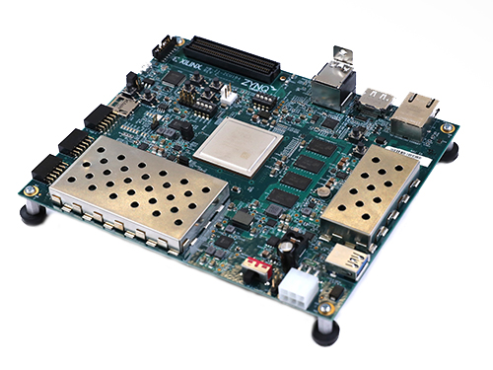
Project Summary
Issues Our Solution Seeks to Fix
Retail Traders are inexperienced
Analysis tools are expensive
Paywalls to professional analytics
Our Solution: A GRU Based Stock Prediction System (GBSPS)
Provide a low cost machine learning system capable of running on limited processing power devices.
Provide retail traders with an easy-to-use tool for analyzing stock data and create a accurate prediction of the direction of stock price movement.
Facts
Current estimates place 32% of total U.S. equity volume to be represented by retail traders [ConOps].
The number of active retail traders across six largest non-commission platforms was 100 million [ConOps ( statistic from Jan. 2021)].
Notes:
Kevin

Slide 3
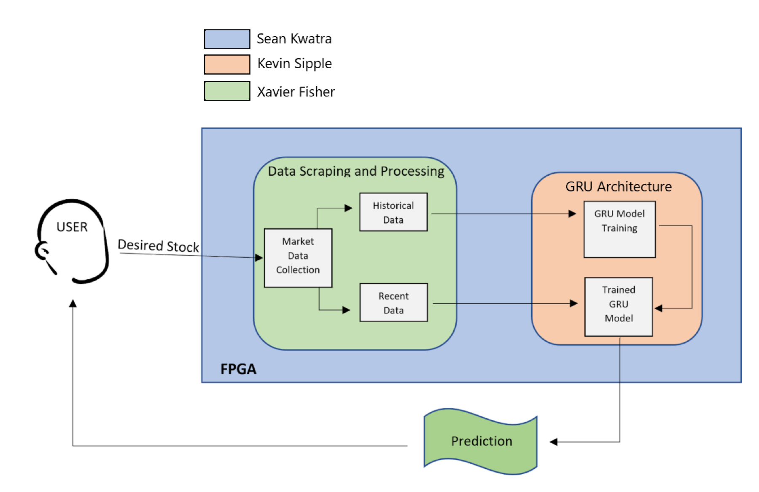
Subsystem Overview
GRU Arch. - Applies available data to train numerous models
FPGA - Integrates software/scripts onto the
board for usage
Data Scraping - collects the available stock data from various sources and creates file for GRU to use
Notes:
Kevin

Slide 4
Key Timeline Milestones
These are our large scope tasks needed to achieve full integration.
Meet with Sponsor for initial 404 Update (ASAP) | Load first GRU onto the FPGA for test run (8/29) | Create a user input/error system compatible with all subsystems (9/26) | Integrate the Data Scraper with the GRU (10/10) | Fully integrate the final scripts onto the FPGA “Full integration” (10/31)
Group | Sean | Kevin & Xavier | Group | Sean

Slide 5
Data Scraping and Processing Subsystem
Accomplishments since Bi-week 1 5 hrs of effort | Ongoing progress/problems and plans until the next presentation
Researched sentiment analysis techniques Executed onboard | Implement viable sentiment analysis techniques Integrate with GRU subsystem
Notes:
Xavier

Slide 6
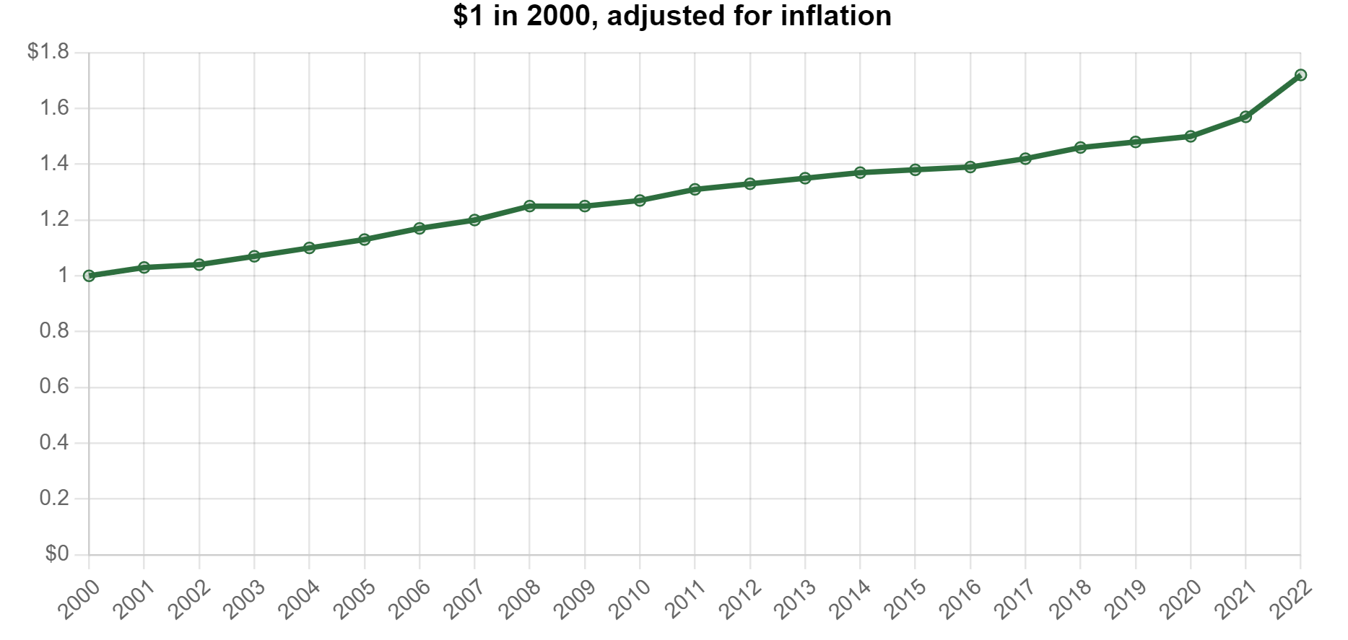
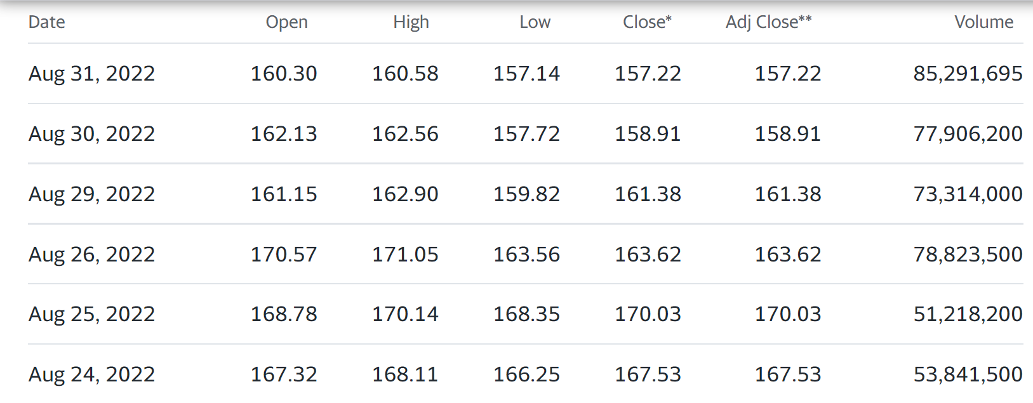
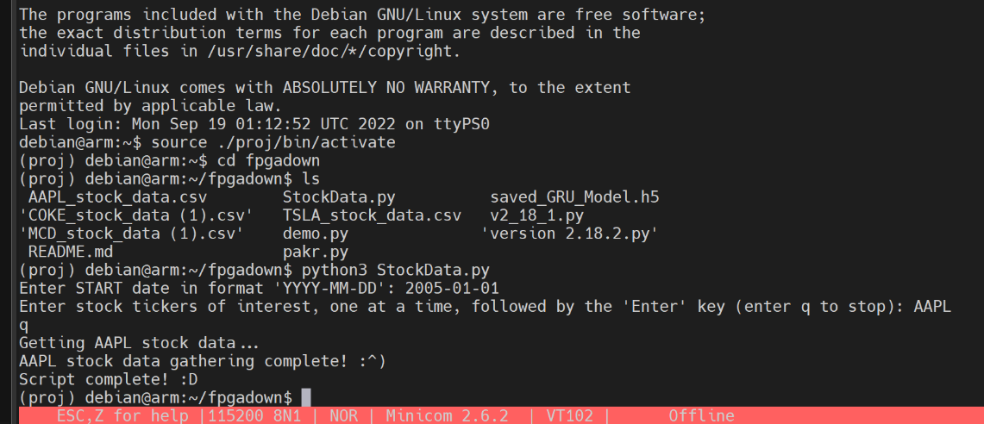
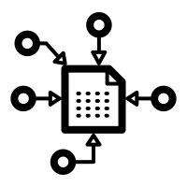
Data Scraping and Processing Subsystem
Notes:
Xavier

Slide 7
FPGA Subsystem
Sean Kwatra
Accomplishments since Bi-week 1 14 hrs of effort | Ongoing progress/problems and plans until the next presentation
Successfully ran multiple GRUs Successfully tested stock data to integrate into GRU | Continue to implement new GRU’s Continue to give feedback
Notes:
sean

Slide 8
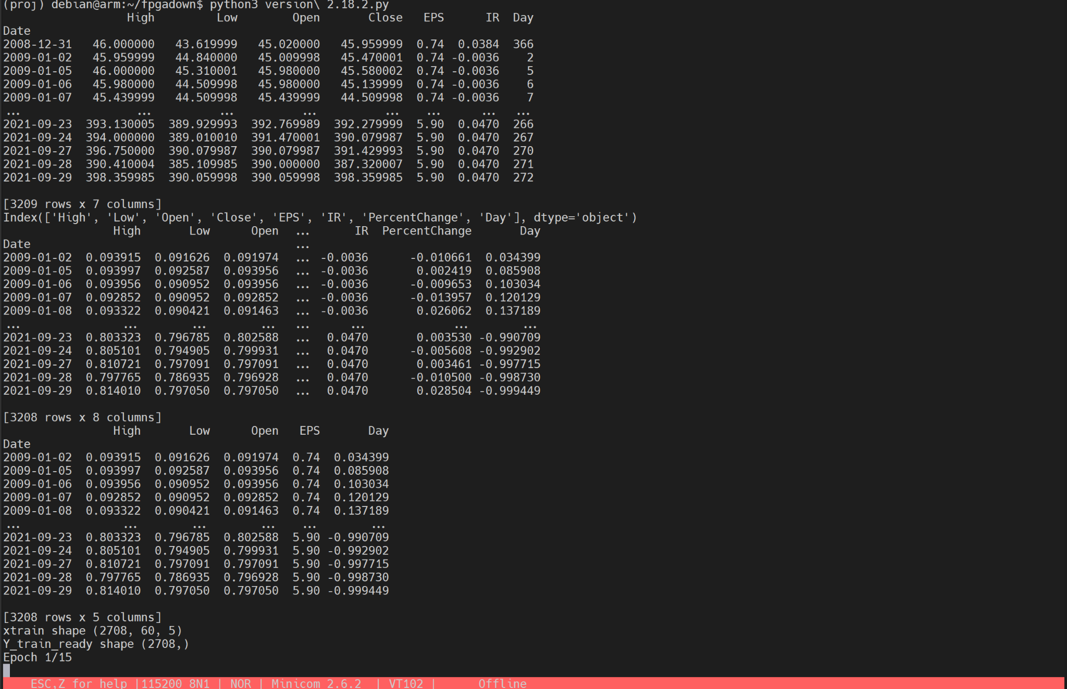
FPGA Subsystem
Sean Kwatra
Trained multiple GRU’s on the FPGA in 30 min.
Saved the best one to use for later.
Started integration of the data scraping subsystem.
Notes:
sean

Slide 9
GRU Architect Subsystem
Kevin H. Sipple
Accomplishments since Bi-week 1 5 hrs of effort | Ongoing progress/problems and plans until the next presentation
The script was updated for model saving/loading (ver 2.18.2) Reach out to Econ Department. | Create error catches Start Integrate the GRU to directly receive data from the data scraper Make script for automatically organizing/formatting the data
Completed One Validation: Test GRU script to ensure best found model is saved and used for predictions
By next update: Complete Error catches and begin scrapper integration
Note on tasks: Error catching must be comprehension

Slide 10
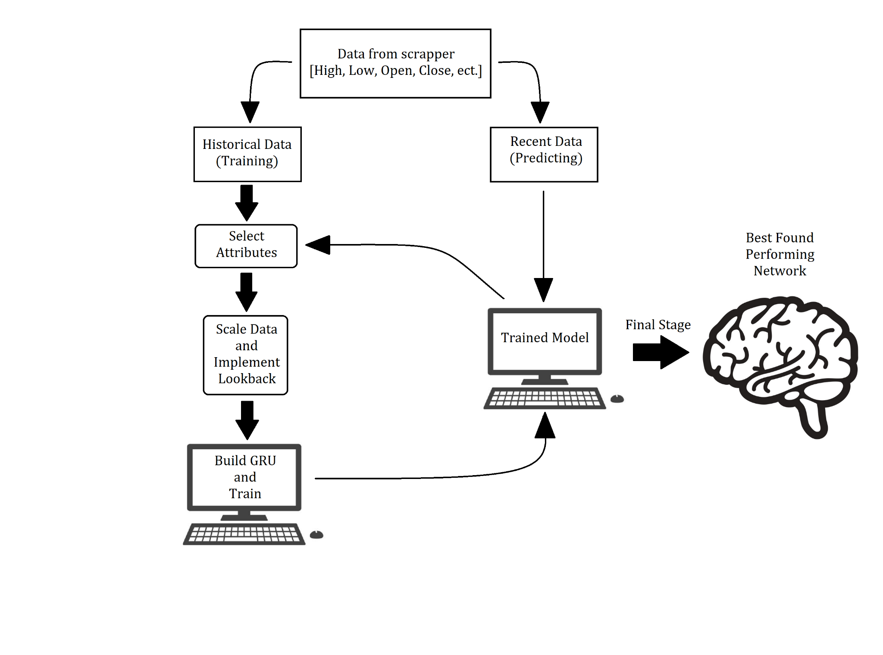
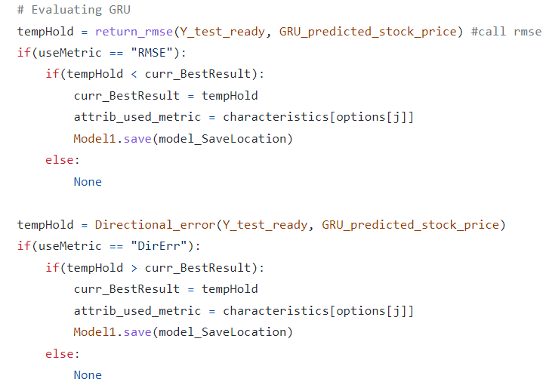
GRU Architect Subsystem

Slide 11
404 - Execution Plan
Not Started
Complete
In Progress
Delayed
Cancelled
Task has been undecided
TASKS | 8/29 | 9/5 | 9/12 | 9/19 | 9/26 | 10/3 | 10/10 | 10/17 | 10/24 | 10/31 | 11/7 | 11/14 | 11/21 | 11/28
Create GitHub for project - S
Meet with sponsor - Gr
Make GRU save best model for use - K
Test performance, accuracy, and FPGA compatibility - S & K
Market sentiment issue sorted out - X
Debug Google Trends - X
Bi-weekly Update #1 - Gr
Create User input system - X & K
Integrate GRU Script and Data Scraping Script - X & K
Bi-weekly Update #2 - Gr
Install Drivers for FPGA to run on monitor -S
Start Designing case -S
Integrate the full software of GRU and Data Scraper -Gr
Print case and mount onto FPGA - S
Bi-weekly Update #3 - Gr
Bi-weekly Update #4 - Gr
Bi-weekly Update #5 - Gr
Final Design Presentation - Gr
Thanksgiving Break
FINAL REPORT DUE 3rd
Notes:
Xavier

Slide 12
Key Validations
Test GRU script to ensure best found model is saved and used for predictions | Test error handling capability and data formatting to ensure script can handle bad or missing data points | Test user input system error handling and run multiple tickers to test functionality | Run a GRU script on the FPGA to ensure models can be trained on board | Run the GRU on a wide selection of stocks and sectors to test usability/ accuracy
Kevin | Kevin | Group | Sean | Kevin & Xavier

Slide 13
Thank you for listening.
Questions?

